Slide 1
Chapter 5: Control Structures II (Repetition)

Slide 2
Objectives
In this chapter, you will:
Learn about repetition (looping) control structures
Explore how to construct and use counter-controlled, sentinel-controlled, flag-controlled, and EOF-controlled repetition structures
Examine break and continue statements
Discover how to form and use nested control structures

Slide 3
Objectives (cont’d.)
In this chapter, you will (cont’d.):
Learn how to avoid bugs by avoiding patches
Learn how to debug loops

Slide 4
Why Is Repetition Needed?
Repetition allows efficient use of variables
Can input, add, and average multiple numbers using a limited number of variables
For example, to add five numbers:
Declare a variable for each number, input the numbers and add the variables together
Create a loop that reads a number into a variable and adds it to a variable that contains the sum of the numbers

Slide 5

while Looping (Repetition) Structure
Syntax of the while statement:
statement can be simple or compound
expression acts as a decision maker and is usually a logical expression
statement is called the body of the loop
The parentheses are part of the syntax

Slide 6
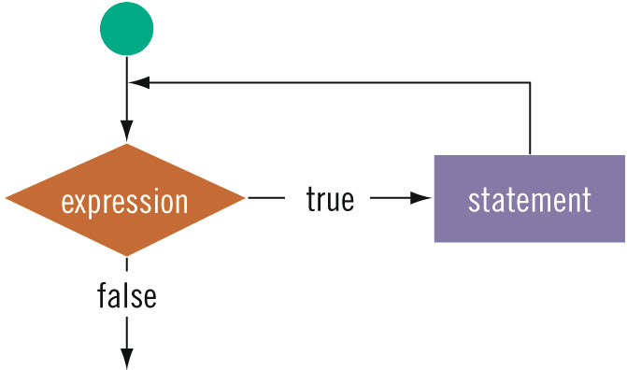
while Looping (Repetition) Structure (cont’d.)

Slide 7
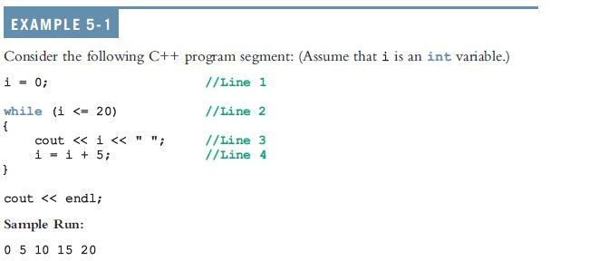
while Looping (Repetition) Structure (cont’d.)

Slide 8
while Looping (Repetition) Structure (cont’d.)
i in Example 5-1 is called the loop control variable (LCV)
Infinite loop: continues to execute endlessly
Avoided by including statements in loop body that assure the exit condition is eventually false

Slide 9
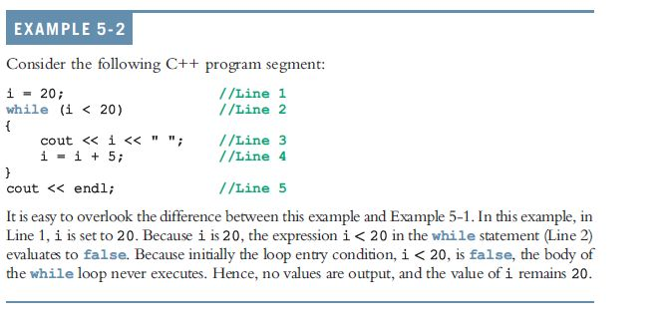
while Looping (Repetition) Structure (cont’d.)

Slide 10
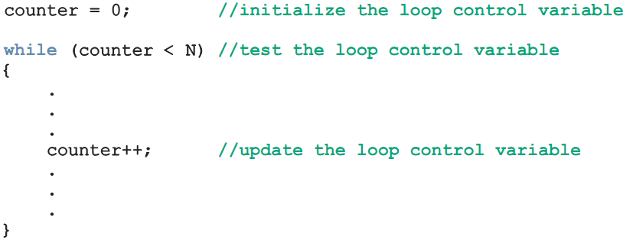
Case 1: Counter-Controlled while Loops
When you know exactly how many times the statements need to be executed
Use a counter-controlled while loop

Slide 11
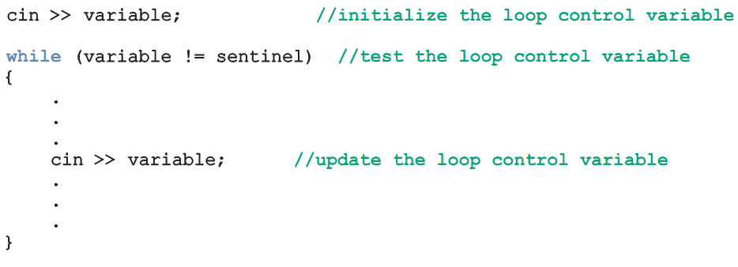
Case 2: Sentinel-Controlled while Loops
Sentinel variable is tested in the condition
Loop ends when sentinel is encountered

Slide 12
Example 5-5: Telephone Digits
Example 5-5 provides an example of a sentinel-controlled loop
The program converts uppercase letters to their corresponding telephone digit

Slide 13
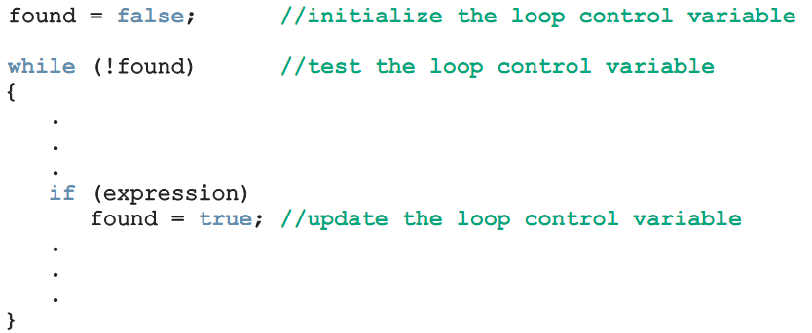
Case 3: Flag-Controlled while Loops
Flag-controlled while loop: uses a bool variable to control the loop

Slide 14
Number Guessing Game
Example 5-6 implements a number guessing game using a flag-controlled while loop
Uses the function rand of the header file cstdlib to generate a random number
rand() returns an int value between 0 and 32767
To convert to an integer >= 0 and < 100:
rand() % 100

Slide 15
Case 4: EOF-Controlled while Loops
End-of-file (EOF)-controlled while loop: when it is difficult to select a sentinel value
The logical value returned by cin can determine if there is no more input

Slide 16
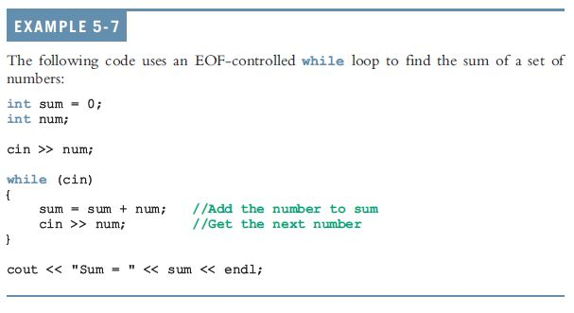
Case 4: EOF-Controlled while Loops (cont’d.)

Slide 17

eof Function
The function eof can determine the end of file status
eof is a member of data type istream
Syntax for the function eof:
istreamVar is an input stream variable, such as cin

Slide 18
More on Expressions in while Statements
The expression in a while statement can be complex
Example:
while ((noOfGuesses < 5) && (!isGuessed))
{
. . .
}

Slide 19
Programming Example: Fibonacci Number
Consider the following sequence of numbers:
1, 1, 2, 3, 5, 8, 13, 21, 34, ....
Called the Fibonacci sequence
Given the first two numbers of the sequence (say, a1 and a2)
n^{th} number a_{n}, n >= 3, of this sequence is given by: a_{n} = a_{n-1} + a_{n-2}

Slide 20
Programming Example: Fibonacci Number (cont’d.)
Fibonacci sequence
n^{th} Fibonacci number
a₂ = 1
a₁ = 1
Determine the n^{th} number a_{n}, n >= 3

Slide 21
Programming Example: Fibonacci Number (cont’d.)
Suppose a₂ = 6 and a₁ = 3
a₃ = a₂ + a₁ = 6 + 3 = 9
a₄ = a₃ + a₂ = 9 + 6 = 15
Write a program that determines the n^{th} Fibonacci number, given the first two numbers

Slide 22
Programming Example: Input and Output
Input: first two Fibonacci numbers and the desired Fibonacci number
Output: n^{th} Fibonacci number

Slide 23
Programming Example: Problem Analysis and Algorithm Design
Algorithm:
Get the first two Fibonacci numbers
Get the desired Fibonacci number
Get the position, n, of the number in the sequence
Calculate the next Fibonacci number
Add the previous two elements of the sequence
Repeat Step 3 until the n^{th} Fibonacci number is found
Output the n^{th} Fibonacci number

Slide 24
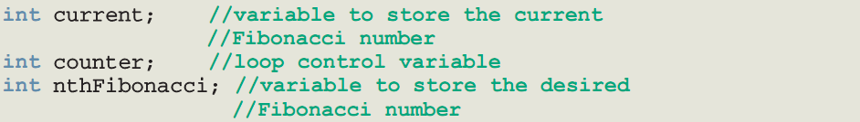
Programming Example: Variables

Slide 25
Programming Example: Main Algorithm
Prompt the user for the first two numbers—that is, previous1 and previous2
Read (input) the first two numbers into previous1 and previous2
Output the first two Fibonacci numbers
Prompt the user for the position of the desired Fibonacci number

Slide 26
Programming Example: Main Algorithm (cont’d.)
Read the position of the desired Fibonacci number into nthFibonacci
if (nthFibonacci == 1) The desired Fibonacci number is the first Fibonacci number; copy the value of previous1 into current
else if (nthFibonacci == 2) The desired Fibonacci number is the second Fibonacci number; copy the value of previous2 into current

Slide 27
Programming Example: Main Algorithm (cont’d.)
else calculate the desired Fibonacci number as follows:
Start by determining the third Fibonacci number
Initialize counter to 3 to keep track of the calculated Fibonacci numbers.
Calculate the next Fibonacci number, as follows: current = previous2 + previous1;

Slide 28
Programming Example: Main Algorithm (cont’d.)
(cont’d.)
Assign the value of previous2 to previous1
Assign the value of current to previous2
Increment counter
Repeat until Fibonacci number is calculated:
while (counter <= nthFibonacci)
{
current = previous2 + previous1;
previous1 = previous2;
previous2 = current;
counter++;
}

Slide 29
Programming Example: Main Algorithm (cont’d.)
Output the nthFibonacci number, which is current

Slide 30
Assignment Operators
Assignment expression abbreviations
c = c + 3; can be abbreviated as c += 3; using the addition assignment operator
Statements of the form
variable = variable operator expression;
can be rewritten as
variable operator= expression;
Examples of other assignment operators include:
d -= 4 (d = d - 4)
e *= 5 (e = e * 5)
f /= 3 (f = f / 3)
g %= 9 (g = g % 9)

Slide 31
Increment and Decrement Operators
Increment operator (++) - can be used instead of c += 1
Decrement operator (--) - can be used instead of c -= 1
Preincrement
When the operator is used before the variable (++c or --c)
Variable is changed, then the expression it is in is evaluated.
Postincrement
When the operator is used after the variable (c++ or c--)
Expression the variable is in executes, then the variable is changed.
If c = 5, then
cout << ++c; prints out 6 (c is changed before cout is executed)
cout << c++; prints out 5 (cout is executed before the increment. c now has the value of 6)

Slide 32
Increment and Decrement Operators
When Variable is not in an expression
Preincrementing and postincrementing have the same effect.
++c;
cout << c;
and
c++;
cout << c;
have the same effect.

Slide 33
Increment & Decrement Operators Examples
int c; c=5; cout<<c<<endl; 5 cout<<c++<<endl; 5 cout<<c<<endl; 6 cout<<“===\n”; === int c; c=5; cout<<c<<endl; 5 cout<<++c<<endl; 6 cout<<c<<endl; 6
OUTPUT
OUTPUT

Slide 34
Increment & Decrement Operators Examples
int c; c=5; cout<<c<<endl; 5 cout<<c- -<<endl; 5 cout<<c<<endl; 4 cout<<“===\n”; === c=5; cout<<c<<endl; 5 cout<<- -c<<endl; 4 cout<<c<<endl; 4

Slide 35
Increment & Decrement Operators Example
/* The following code demonstrates true use of several format for increment & decrement operators. */
counter=1;
do {
counter ++;
counter+=1;
++ counter;
} while(counter<=10);
counter=10;
do {
counter --;
counter-=1;
-- counter;
} while(counter>=0);

Slide 36

for Looping (Repetition) Structure
for loop: called a counted or indexed for loop
Syntax of the for statement:
The initial statement, loop condition, and update statement are called for loop control statements

Slide 37
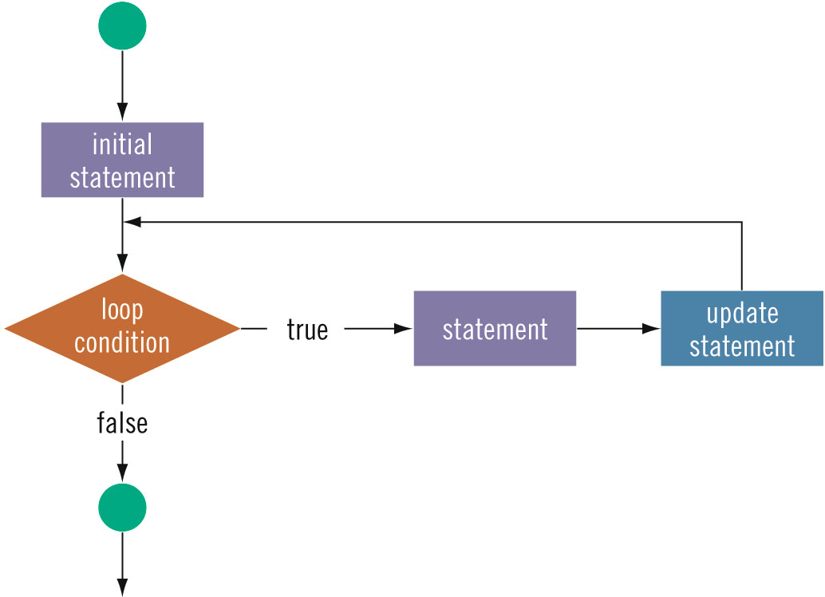
for Looping (Repetition) Structure (cont’d.)

Slide 38
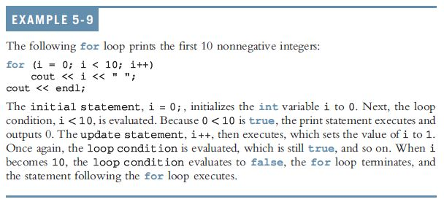
for Looping (Repetition) Structure (cont’d.)

Slide 39
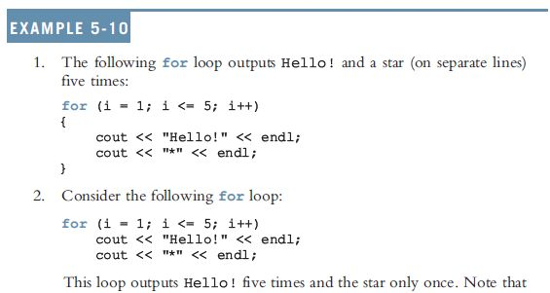
for Looping (Repetition) Structure (cont’d.)

Slide 40
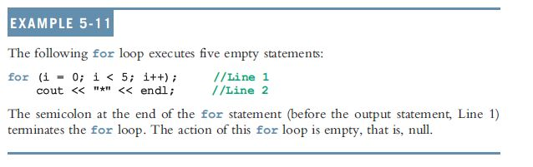
for Looping (Repetition) Structure (cont’d.)
The following is a semantic error:
The following is a legal (but infinite) for loop:
for (;;)
cout << "Hello" << endl;

Slide 41
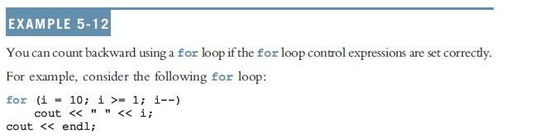
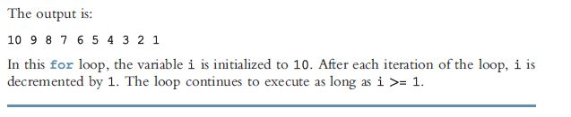
for Looping (Repetition) Structure (cont’d.)

Slide 42
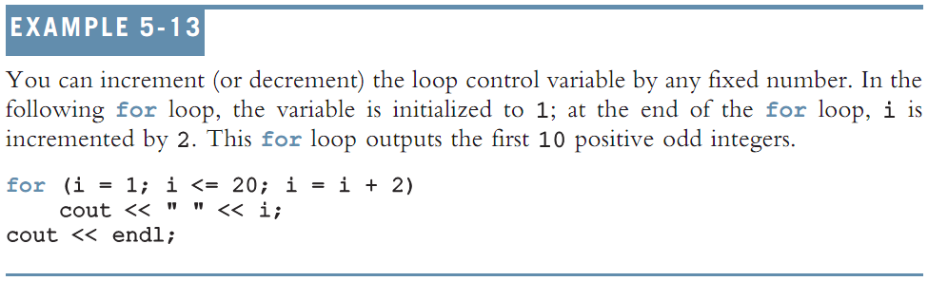
for Looping (Repetition) Structure (cont’d.)

Slide 43
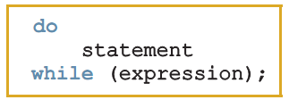
do…while Looping (Repetition) Structure
Syntax of a do...while loop:
The statement executes first, and then the expression is evaluated
As long as expression is true, loop continues
To avoid an infinite loop, body must contain a statement that makes the expression false

Slide 44
do…while Looping (Repetition) Structure (cont’d.)
The statement can be simple or compound
Loop always iterates at least once

Slide 45
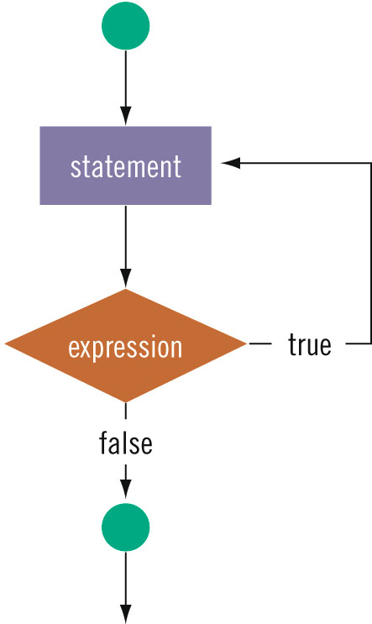
do…while Looping (Repetition) Structure (cont’d.)

Slide 46
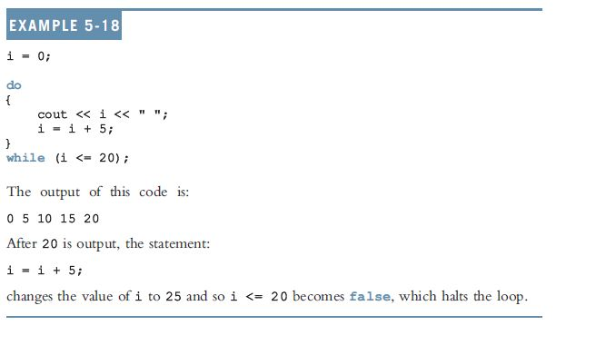
do…while Looping (Repetition) Structure (cont’d.)

Slide 47
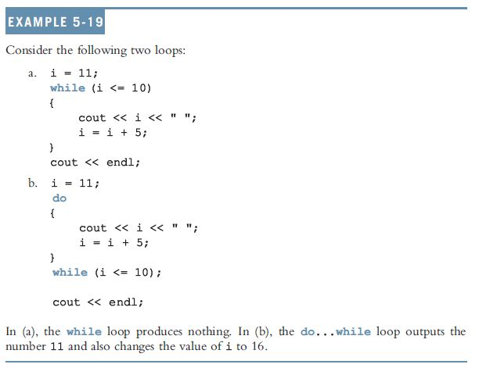
do…while Looping (Repetition) Structure (cont’d.)

Slide 48
Choosing the Right Looping Structure
All three loops have their place in C++
If you know or can determine in advance the number of repetitions needed, the for loop is the correct choice
If you do not know and cannot determine in advance the number of repetitions needed, and it could be zero, use a while loop
If you do not know and cannot determine in advance the number of repetitions needed, and it is at least one, use a do...while loop

Slide 49
break and continue Statements
break and continue alter the flow of control
break statement is used for two purposes:
To exit early from a loop
Can eliminate the use of certain (flag) variables
To skip the remainder of a switch structure
After break executes, the program continues with the first statement after the structure

Slide 50
break and continue Statements (cont’d.)
continue is used in while, for, and do…while structures
When executed in a loop
It skips remaining statements and proceeds with the next iteration of the loop

Slide 51
Nested Control Structures
To create the following pattern:
*
**
***
****
*****
We can use the following code:
for (i = 1; i <= 5 ; i++)
{
for (j = 1; j <= i; j++)
cout << "*";
cout << endl;
}

Slide 52
Nested Control Structures (cont’d.)
What is the result if we replace the first for statement with this?
for (i = 5; i >= 1; i--)
Answer:
*****
****
***
**
*

Slide 53
Avoiding Bugs by Avoiding Patches
Software patch
Piece of code written on top of an existing piece of code
Intended to fix a bug in the original code
Some programmers address the symptom of the problem by adding a software patch
Should instead resolve underlying issue

Slide 54
Debugging Loops
Loops are harder to debug than sequence and selection structures
Use loop invariant
Set of statements that remains true each time the loop body is executed
Most common error associated with loops is off-by-one

Slide 55
Summary
C++ has three looping (repetition) structures:
while, for, and do…while
while, for, and do are reserved words
while and for loops are called pretest loops
do...while loop is called a posttest loop
while and for may not execute at all, but do...while always executes at least once

Slide 56
Summary (cont’d.)
while: expression is the decision maker, and statement is the body of the loop
A while loop can be:
Counter-controlled
Sentinel-controlled
EOF-controlled
In the Windows console environment, the end-of-file marker is entered using Ctrl+z

Slide 57
Summary (cont’d.)
for loop: simplifies the writing of a counter-controlled while loop
Putting a semicolon at the end of the for loop is a semantic error
Executing a break statement in the body of a loop immediately terminates the loop
Executing a continue statement in the body of a loop skips to the next iteration

